Slide 1
Compiler Design
How Are Identifiers and Keywords Distinguished

Slide 2
Presentation Overview
Introduction and Relevance Compiler Phases
Compiler Phases Overview
Definitions: Keywords vs. Identifiers
Recognition Mechanisms (DFA, Tables)
Key Differences and Rules
Examples, Errors, and Best Practices
Conclusion and References

Slide 3
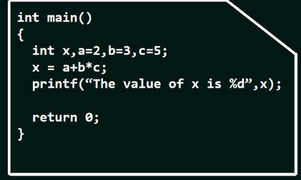
What Is a Compiler?
System software
Translates source code to machine code
Performs analysis and error checking
Source code consists of tokens: keywords, identifiers, literals, operators, etc.
Distinction is the first step in compilation to produce a valid token stream.
Handled entirely in the lexical analysis phase (scanner/lexer).

Slide 4
Relevance in Compiler Design
Why important?
Enables error-free parsing and subsequent phases.

Slide 5
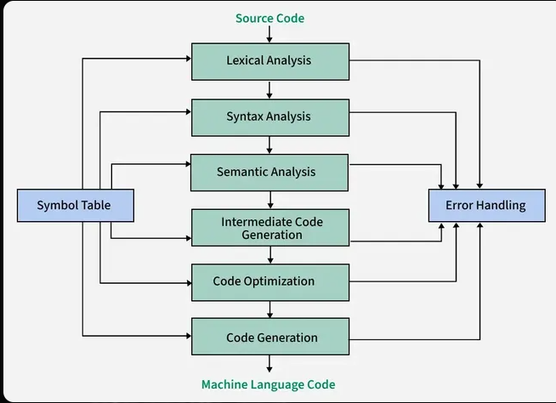
Compiler Phases Overview
Main phases: Lexical Analysis → Syntax → Semantic → Intermediate Code → Optimization → Code Generation.
Lexical analyzer converts character stream to token stream.

Slide 6
Lexical Analysis Phase (Lexer/Scanner)
Input: Source code characters.
Output: Tokens (type + lexeme).
Removes whitespace/comments.
Uses regular expressions and finite automata.

Slide 7
Con…
int sum = a + b; // Comment Hi
Lexeme | Token Type | Notes
int | Keyword | Reserved word
sum | Identifier | Variable name
= | Operator | Assignment
a | Identifier | Variable name
+ | Operator | Arithmetic (addition)
b | Identifier | Variable name
; | Punctuation/Separator | Statement terminator

Slide 8
What Are Keywords?
Reserved words with fixed meaning (e.g., if, while, int, class).
Hard-coded in the lexer (keyword table/hash map).
Classified as specific token types (e.g., TOKEN_IF).
Cannot be used as identifiers.

Slide 9
What Are Identifiers?
User-defined names for variables, functions, etc.
Follow pattern: letter (or ) followed by letters/digits/.
Classified as generic IDENTIFIER token.
Lexeme inserted into symbol table for later phases.

Slide 10
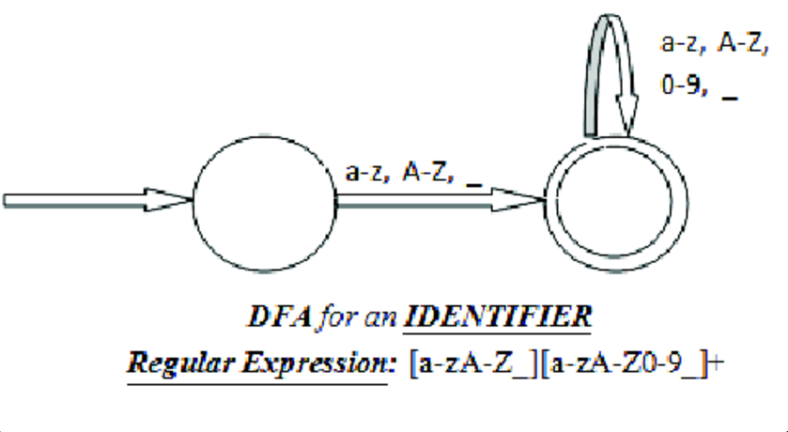
Recognition Using Finite Automata
Lexer implements DFA from regular expressions.
Identifier pattern: [a-zA-Z_][a-zA-Z0-9_]*
Keywords: Exact match priority.
IDENTIFIER
fName; Right
9name; Erorr
KEYWORD
if,int….

Slide 11
Keyword Table
Keyword | Token Type | Purpose
if | KEYWORD_IF | Used for conditional execution (if statement)
int | KEYWORD_INT | Declares a variable of integer data type
while | KEYWORD_WHILE | Used for loop execution as long as a condition is true

Slide 12
Distinction Process in Lexer
Algorithm:
1.Scan characters, match longest lexeme.
2.If matches identifier pattern:
  Check against keyword table.
  If match → Keyword token.
  Else → Identifier token + add to symbol table.
Example: "if" → Keyword; "iff" → Identifier.

Slide 13
Key Differences - Comparison Table
Aspect | Keywords | Identifiers
Source | Predefined/reserved | User-defined
Recognition | Exact match in table | Pattern match + table check
Token Type | Specific (e.g., IF, WHILE) | Generic ID
Symbol Table | Not inserted | Inserted with attributes
Purpose | Control syntax | Name entities

Slide 14
Rules and Examples
Identifier rules: Regex [a-zA-Z_][a-zA-Z0-9_]*
Code examples:
    Valid: int count; (int = keyword, count = identifier)
    Invalid: int int = 5; (lexical error)

Slide 15
Common Errors and Handling
Errors: Using keyword as identifier → Lexical error reported.
Longest match rule prevents ambiguity.
In tools like Flex: Automatic handling.

Slide 16
Conclusion
Summary: Distinction occurs in lexical phase via pattern matching (DFA), keyword lookup, and symbol table management.
Key Takeaway: Fundamental for correct tokenization and efficient compilation.

Slide 17
References
Alfred V. Aho et al., "Compilers: Principles, Techniques, and Tools" (Dragon Book), 2nd Edition.
GeeksforGeeks: "Phases of Compiler" and "Lexical Analysis".
Tutorialspoint: "Compiler Design - Symbol Table" and "Lexical Analysis".

Slide 18
Thank you!

